Slide 1
Course Eight
Week Three
Notes:
Python Maps with Folium https://www.youtube.com/watch?v=t9Ed5QyO7qY

Slide 2
Objectives
Demonstrate how to use advanced visualization tools to create waffle charts and world clouds
Use Seaborn with Matplotlib to generate attractive regression plots
Describe the use of Folium and use it to create maps, superpose markers, and create Choropleth maps

Slide 3
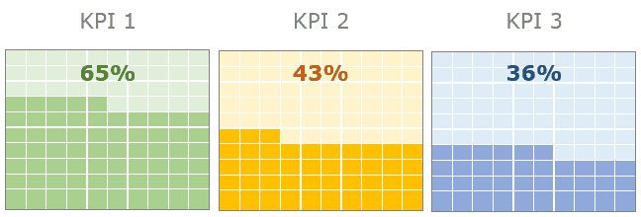
Waffle Charts
Advanced visualization tool
Visualization that displays progress towards goals
Height and width are defined
Matplotlib does not have a function to create waffle charts 🡪 you will create your own Python function

Slide 4
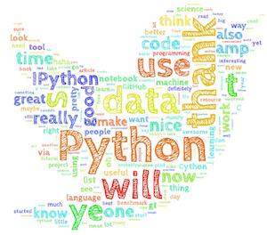
Word Cloud
Depiction of the importance of different words in the body of a text
The more a word appears, the bigger and bolder it appears in the word cloud
Matplotlib does not have a function to create word charts 🡪 Mueller’s publicly available word-cloud generator

Slide 5
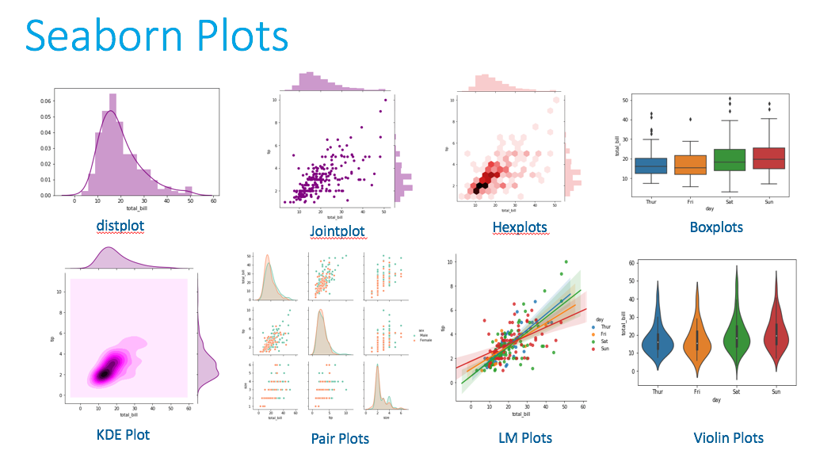
Seaborn
Python visualization library
Based on Matplotlib
Makes creating plots efficient using 5x less code

Slide 6
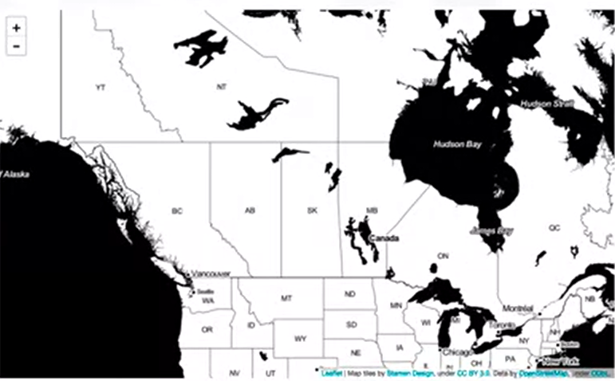
Visualizing Geospatial Data 🡪 Folium
Create interactive map of any location in the world if you know the longitude and latitude values
Street maps, stamen maps, etc.
Call the map function
Example of a Folium map using Stamen Toner
m = folium.Map(location=[60.25, 24.8], zoom_start=10, control_scale=True)
optional : tiles='Stamen Toner'
Notes:
Default map 🡪 street map 🡪 zoomed in shows street view of an area while zoomed out shows you borders of the country
Stamen Toner 🡪 shades water 🡪 good for visualizing rivers and coastal zones
Stamen Terrain 🡪 good for highlighting hill shading and natural vegetation colours

Slide 7
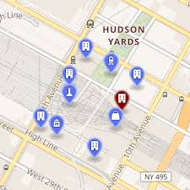
Maps with Markers
Create a feature group
Create “children” to add to the feature group
Specify latitude and longitude values to superimpose the “child” onto the map
Label the marker by using the marker function and pop-up parameter
It is also possible to create clusters of markers

Slide 8
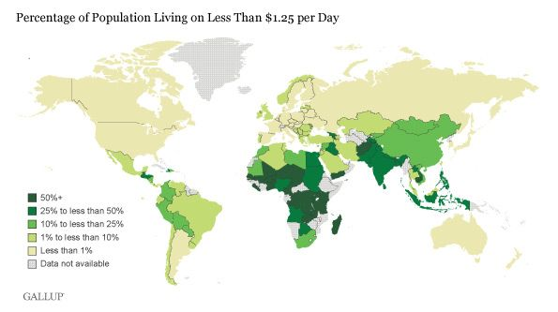
Choropleth Maps
Thematic map
Areas are shaded or patterned in proportion to the measurement of the statistical variable displayed on the map like population or income
Higher the measurement = darker colour
To create this map using Folium, a Geo JSON file is needed
First, create a map using Folium
Then, to convert it to a choropleth map, define a variable that points to the JSON file
Apply the choropleth function identifying the columns you want to highlight as well as the country names

Slide 9
Review
Which of this is not a data visualization library for Python?
Seaborn
Matplotlib
Numpy
Folium

Slide 10
Review
Which of this is not a data visualization library for Python?
Seaborn
Matplotlib
Numpy
Folium

Slide 11
Review
What chart is best used for representing discrete continuous values?
Bar chart
Pie chart
Histogram
Word Chart

Slide 12
Review
What chart is best used for representing discrete continuous values?
Bar chart
Pie chart
Histogram
Word Chart

Slide 13
Review
What method is used to create a regression line in seaborn?
sns.regplot(x="column", y="column", data=df);
sns.histplot(x="column", y="column", data=df);
sns.boxplot(x="column", y="column", data=df);
sns.heatmap(x="column", y="column", data=df);

Slide 14
Review
What method is used to create a regression line in seaborn?
sns.regplot(x="column", y="column", data=df);
sns.histplot(x="column", y="column", data=df);
sns.boxplot(x="column", y="column", data=df);
sns.heatmap(x="column", y="column", data=df);

